Slide 1
Lecture 2

Slide 2
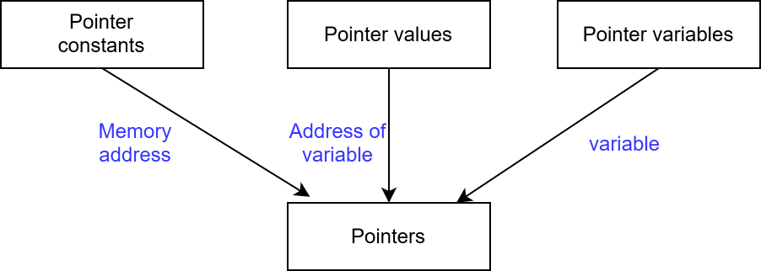
Underlying Concepts of Pointers

Slide 3
Accessing the address of a variable
The address of the variable can be determined by using “&” operator.
The “&” operator is used in scanf() functon previously.
The operator “&” immediately preceding a variable returns the address of the variable associated with it.
ex: p = &quantity;

Slide 4
illegal use of address operator
Pointing at constant. ex: &125 (invalid)
Pointing at array name (invalid)
    int x[10] ;
    &x
Pointing at expression (invalid)
    &(x+y)
Int x[] = {5, 2, 6, 1, 5 , 7};
&x[0] and &x[i+3] are valid.

Slide 5
Declaring Pointer Variable
data_type *pointer_name;
Declaration tells the compiler three things
  asterisk(*) tells that the varible pointer_name is a pointer variable.
  pointer_name needs a memory location.
  pointer_name points to a variable of type data_type.

Slide 6
Continue…
integer pointer
int *p;
int refers to the data type of the variable being pointed by p not the type of the variable being pointed by p.
float pointer
float *x;

Slide 7
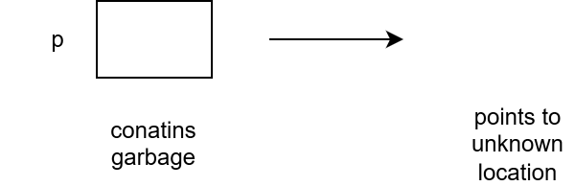
Continue…
All pointer variables are of same size irrespective of their type.
int *p;

